Slide 1


NGUYEN MINH LONG
2023/12/29

Slide 2

Outline
Executive Summary
Introduction
Methodology
Results
Discussion
Conclusion
Appendix

Slide 3


Executive Summary
This goal of the project is to create a machine learning pipeline to predict if the first stage will land successfully.
Problems you want to find answers :
What factors determine if the rocket will land successfully?
The interaction amongst various features that determine the success rate of a successful landing.
What operating conditions needs to be fulfilled to ensure a successful landing program.

Slide 4

Introduction
Predict whether the Falcon 9 first stage will land successfully or not.
Purpose of this project
Determine if the first stage will land.
Determine the cost of a launch.
Information can be used if an alternate company wants to bid against SpaceX for a rocket launch.

Slide 5

Section 1

Slide 6
Methodology
Executive Summary
Data collection methodology:
Collected data will be guaranteed to be in the correct format through the API.
Example: Booster names – https://api.spacexdata.com/v4/rockets/
Perform data wrangling
The data also collects historical Falcon 9 launch records from a Wikipedia page titled ”List of Falcon 9 and Falcon Heavy launches“.
Perform exploratory data analysis (EDA) using visualization and SQL
Perform interactive visual analytics using Folium and Plotly Dash
Perform predictive analysis using classification models
"Logistic Regression", "SVM", "Decision Tree", "KNN“ & Confusion Matrix.

Slide 7
Data Collection
Data collection process involved a combination of API requests from SpaceX public API and web scraping data from a table in SpaceX’s Wikipedia entry.
SpaceX API Data Columns:
FlightNumber, Date, BoosterVersion, PayloadMass, Orbit, LaunchSite, Outcome, Flights, GridFins.
Reused, Legs, LandingPad, Block, ReusedCount, Serial, Longitude, Latitude.
Wikipedia Webscrape Data Columns:
Flight No., Launch site, Payload, PayloadMass, Orbit, Customer, Launch outcome, Version Booster, Booster landing, Date, Time.

Slide 8
Data Collection – SpaceX API
Data Collection – SpaceX API Notebook
https://github.com/Nguyen-Minh-Long/IBM_Data_Science/blob/main/10.%20Applied%20Data%20Science%20Capstone/Week%201/jupyter-labs-spacex-data-collection-api.ipynb
Column has rocket information
Store data from request
SpaceX API
Request
Filter the data
Normalize
GET
Remove, extract
Store in list
Response
Convert, restrict
Combine into a dictionary
Only include “Falcon 9” launches
Missing value
Create Dataframe
Wrangling
Filter “Falcon 9”
Dataframe
Replace “NaN” value
Remove, filtered data
Pandas Dataframe
New dataframe “data_falcon9”
Dictionary

Slide 9
Data Collection - Scraping
Data Collection – Scraping Notebook
https://github.com/Nguyen-Minh-Long/IBM_Data_Science/blob/main/10.%20Applied%20Data%20Science%20Capstone/Week%201/jupyter-labs-webscraping.ipynb
Wikipedia SpaceX
Pulling data out
Relevant column names
Request
Data Extraction
Data Collection
GET
BeautifulSoup
HTML table
Response
html.parser
Extract column name
Empty dictionary with keys
Create Dataframe
Dataframe
Normalize
Pandas Dataframe
Records extracted
Dictionary
Parsing

Slide 10
Data Wrangling
There are several different cases where the booster did not land successfully (True Ocean, True RTLS, …).
We will mainly convert into Training Labels
“1” means the booster successfully landed (True Ocean, True RTLS, …).
“0” means it was unsuccessful (False Ocean, False RTLS, …).
For each value of the Outcome column, we will assign a value of 0 or 1.
Finally, combine the sequence 0 and 1 into the dataset.
Example: Value “True Ocean” will correspond to the value "1" of the new "Class" column.
*Data Wrangling Notebook*
https://github.com/Nguyen-Minh-Long/IBM_Data_Science/blob/main/10.%20Applied%20Data%20Science%20Capstone/Week%201/labs-jupyter-spacex-Data%20wrangling.ipynb

Slide 11
EDA with Data Visualization
In this project, I use scatter plot, bar plot, and line plot. Most of which use scatter plot.
Determining a successes or failed landing depends on many factors, so using a scatter plot is most appropriate when comparing the relationship between two variables.
Example: FlightNumber vs PayloadMass, FlightNumber vs LaunchSite, ...
*EDA with data visualization Notebook*
https://github.com/Nguyen-Minh-Long/IBM_Data_Science/blob/main/10.%20Applied%20Data%20Science%20Capstone/Week%202/jupyter-labs-eda-dataviz.ipynb

Slide 12
EDA with SQL
In this project, the SQL statements used include:
Loaded data set into IBM DB2 Database.
Queried using SQL Python integration.
Queries were made to get a better understanding of the dataset.
Queried information about launch site names, mission outcomes, various pay load sizes of customers and booster versions, and landing outcomes.
*EDA with SQL Notebook*
https://github.com/Nguyen-Minh-Long/IBM_Data_Science/blob/main/10.%20Applied%20Data%20Science%20Capstone/Week%202/jupyter-labs-eda-sql-coursera_sqllite.ipynb

Slide 13
Build an Interactive Map with Folium
Folium maps mark all launch sites, using Circle and Marker. Also including successful or failed launches at each Launch Site. Finally, there are examples of proximity to key locations: Coastline, Railway, Highway, and City using Polyline.
Finding an optimal location for building a launch site certainly involves many factors. *Interactive map with Folium Notebook*
https://github.com/Nguyen-Minh-Long/IBM_Data_Science/blob/main/10.%20Applied%20Data%20Science%20Capstone/Week%203/lab_jupyter_launch_site_location.ipynb

Slide 14
Build a Dashboard with Plotly Dash
Dashboard includes a pie chart and a scatter plot.
A pie chart can be selected to show the distribution of successful landings across all launch site. It can also be used to display the number of successes or failures (in percentage) of each launch site.
Scatter plot takes two inputs: all launch site or each launch site with payload. Payload mass can be adjusted to a value within a range of 0 – 10,000 kg.
The pie chart is used to visualize launch site success rate.
Scatter charts can help show how success varies by launch site, payload volume, and booster version category.
*Dashboard*
https://github.com/Nguyen-Minh-Long/IBM_Data_Science/blob/main/10.%20Applied%20Data%20Science%20Capstone/Week%203/spacex_dash_app.py

Slide 15
Predictive Analysis (Classification)
Class [0, 1]
train_test_split
Fit the object
GridSearchCV
Score
Predict
Assign variable
Data splitting
GridSearchCV
Model
Accuracy
Confusion Matrix
X, Y
Random_state = 2
Parameters
LogReg, SVM
Test data
TP, TN, FP, FN
Preprocessing
Test_size = 0.2
CV = 10
Tree, KNN
X_test, Y_test
Accuracy best score
*Predictive analysis Notebook*
https://github.com/Nguyen-Minh-Long/IBM_Data_Science/blob/main/10.%20Applied%20Data%20Science%20Capstone/Week%204/SpaceX_Machine_Learning_Prediction_Part_5.jupyterlite.ipynb

Slide 16
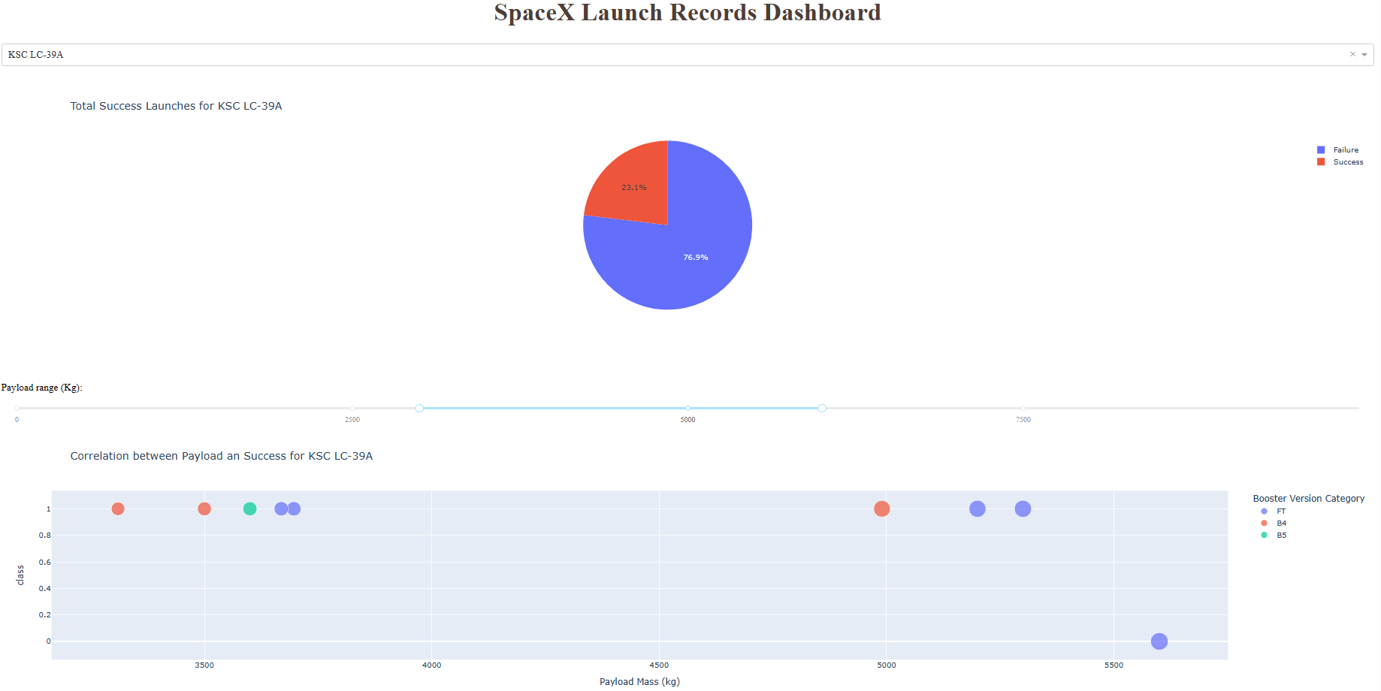
Results
Figure 1: Interactive analytics

Slide 17
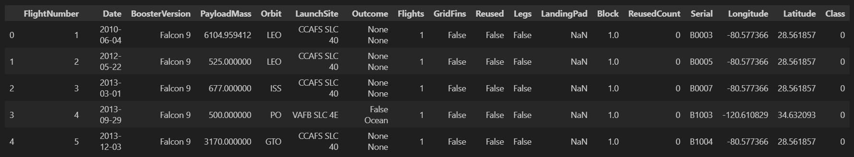
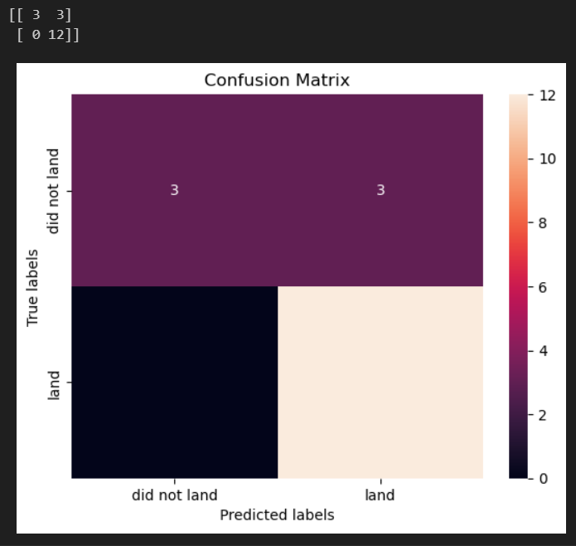
Figure 2: Exploratory data analysis results
Figure 3: Predictive analysis results – Logistic Regression

Slide 18

Section 2

Slide 19
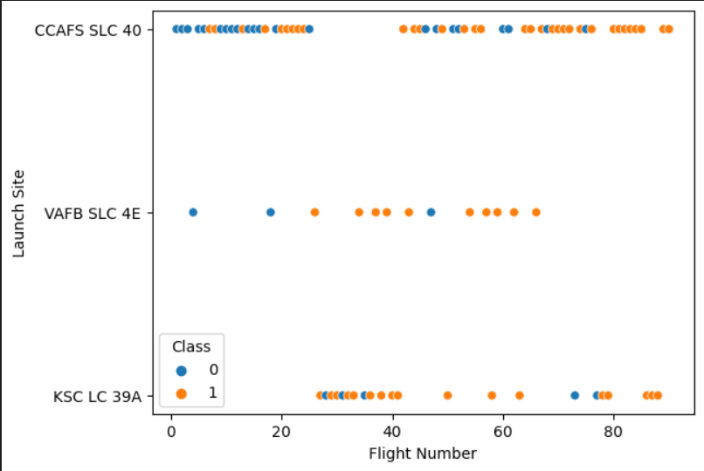
Flight Number vs. Launch Site
It seems that as the number of flights increases, the success rate also increases.
Especially from the 20th flight onwards is a breakthrough period, significantly increasing the success rate.
In addition, CCAFS SLC 40 is the place with the most launches.
Figure 4: Scatter Plot Flight Number vs. Launch Site

Slide 20
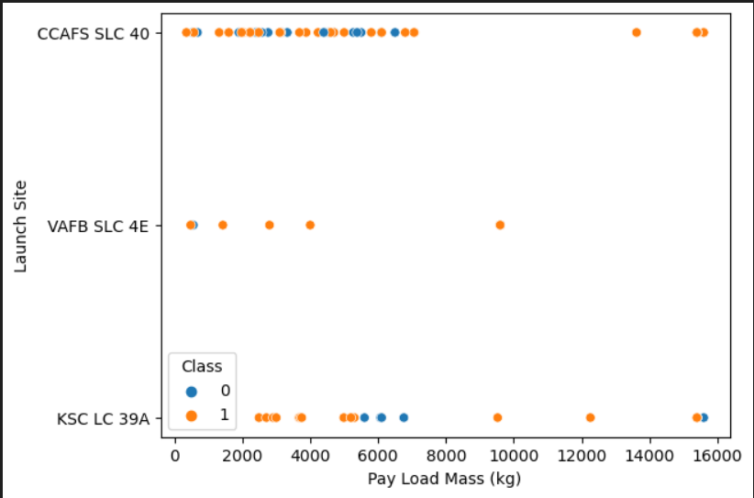
Payload vs. Launch Site
Most of the payload mass is in the range of 0 – 8,000 kg.
The VAFB-SLC Launch Site there are no rockets launched for heavy payload mass (greater than 10,000).
Figure 5: Scatter Plot Payload vs. Launch Site

Slide 21
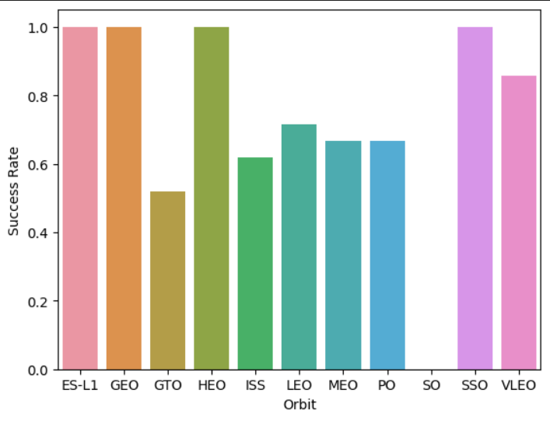
Success Rate vs. Orbit Type
Orbits with a success rate of up to 100% ES-L1, GEO, HEO, SSO.
VLEO has decent success rate and attempts, about 86%.
GTO has the around 50%. success rate but largest sample
SO has 0% success rate.
Figure 6: Bar Plot Success Rate vs. Orbit Type

Slide 22
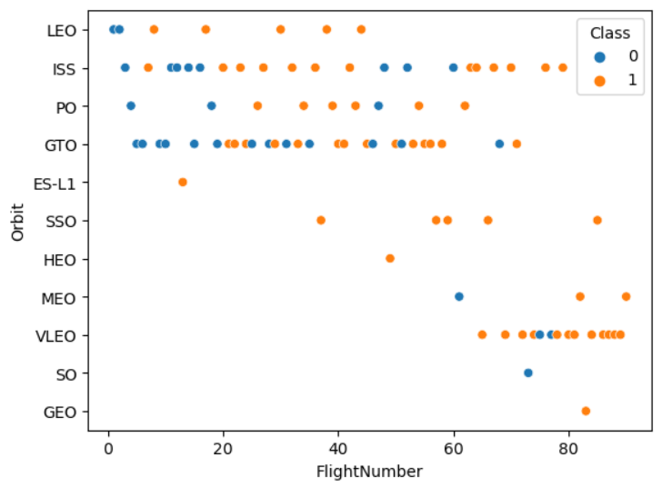
Flight Number vs. Orbit Type
The LEO orbit the Success appears related to the number of flights.
On the other hand, there seems to be no relationship between flight number when in GTO orbit.
Figure 7: Scatter Plot Flight Number vs. Orbit Type

Slide 23
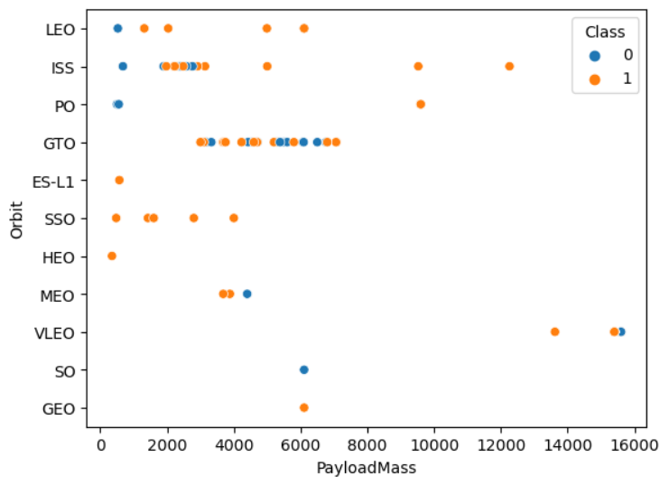
Payload vs. Orbit Type
With heavy payloads the successful landing or positive landing rate are more for Polar, LEO and ISS.
However, for GTO we cannot distinguish this well as both positive landing rate and negative landing(unsuccessful mission) are both there here.
Figure 8: Scatter Plot Payload vs. Orbit Type

Slide 24
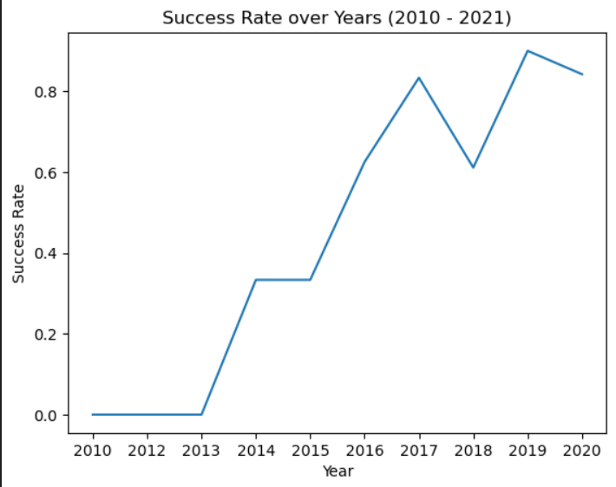
Launch Success Yearly Trend
The success rate since 2013 kept increasing till 2017 (stable in 2014).
After 2015 it started increasing.
Slight decrease in 2018.
Figure 9: Line Plot Launch Success Yearly Trend

Slide 25
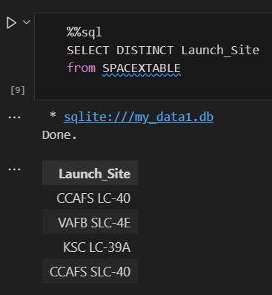
All Launch Site Names
The SELECT DISTINCT statement is used to return only distinct (different) values.
The result has 4 values:
CCAFS LC-40
VAFB SLC-4E
KSC LC-39A
CCAFS SLC-40
Figure 10: All Launch Site Names

Slide 26
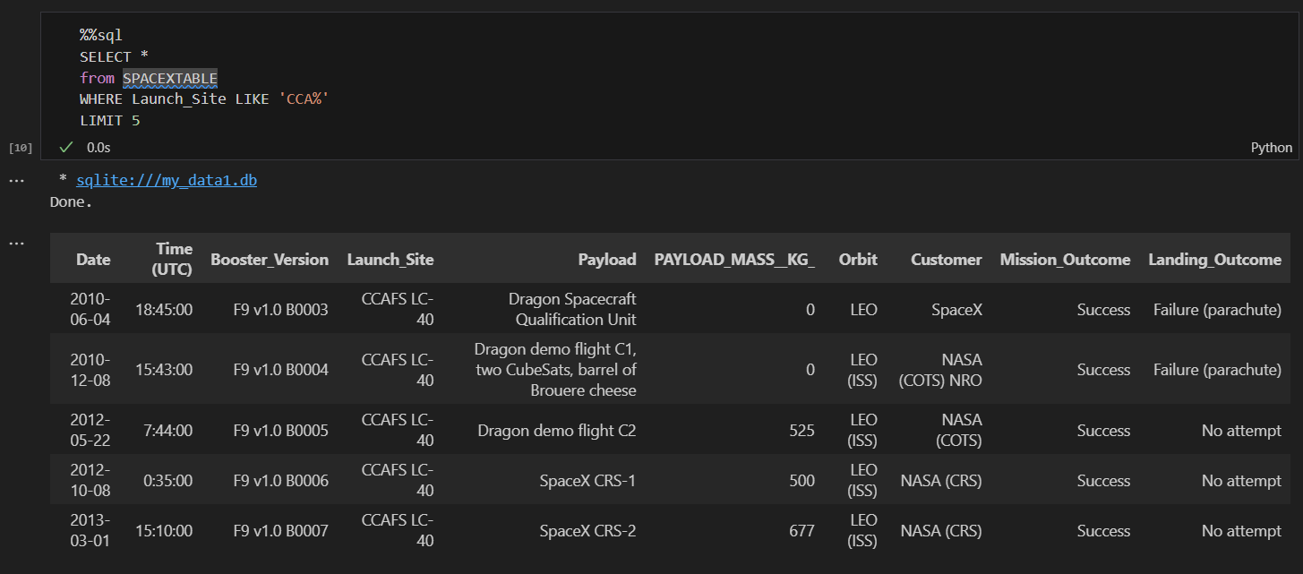
Launch Site Names Begin with 'CCA'
Use the LIKE Operator to find strings starting with “CCA”.
Limit the results displayed using the LIMIT Operator.
Figure 11: Record with Launch Site Names Begin with 'CCA'

Slide 27
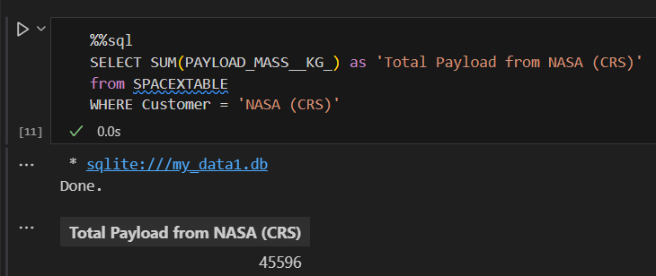
Total Payload Mass
The SUM() function returns the total sum of a numeric column.
The result is 45,596 Kg.
Figure 12: Total Payload Mass

Slide 28
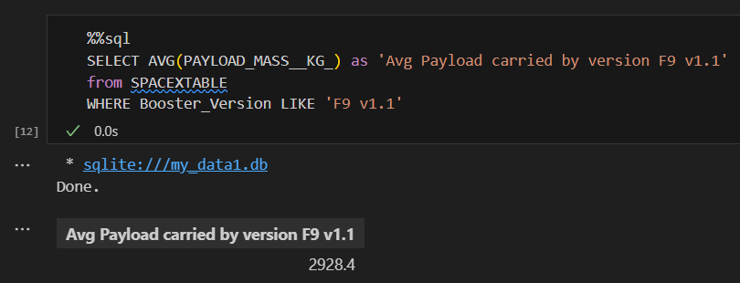
Average Payload Mass by F9 v1.1
The AVG() function returns the average value of a numeric column.
Like Operator used to search for booster version name “F9 v1.1”.
Figure 13: Average Payload Mass by F9 v1.1

Slide 29
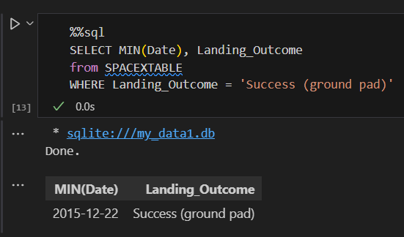
First Successful Ground Landing Date
The MIN() function returns the smallest value of the selected column.
The condition here are successful landing “Success” with landing on the ground “ground pad”.
The results obtained are December 12, 2015.
Figure 14: First Successful Ground Landing Date

Slide 30
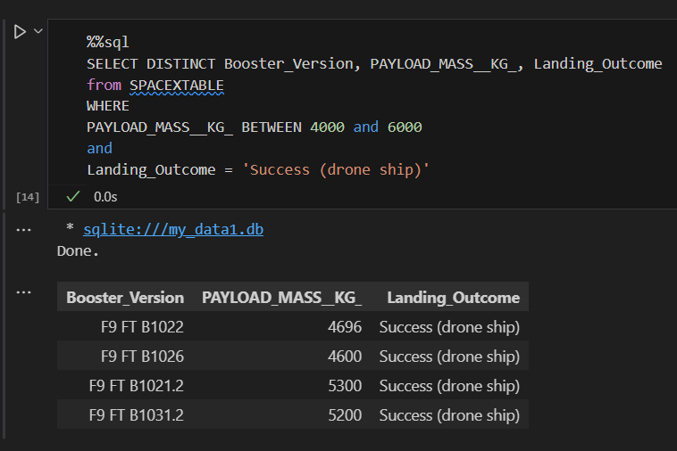
Successful Drone Ship Landing with Payload between 4000 and 6000
The AND operator is used to filter records based on more than one condition.
First condition, have payload mass greater than 4,000 but less than 6,000.
Second condition, landing success on the drone ship .
Figure 15: Successful Drone Ship Landing

Slide 31
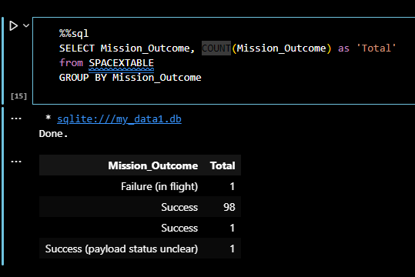
Total Number of Successful and Failure Mission Outcomes
The COUNT() function returns the number of rows that matches a specified criterion.
SpaceX appears to achieve its mission outcome nearly 99% of the time.
Figure 16: Total Number of Successful and Failure

Slide 32
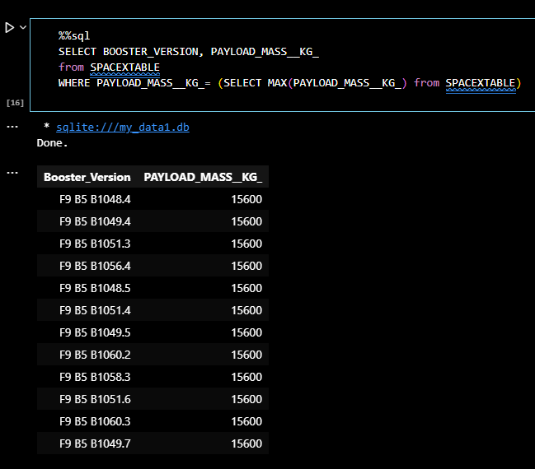
Boosters Carried Maximum Payload
By using subquery, the result obtained from subquery is 15,600 kg.
Returning to the main clause, we will list booster names with payload mass reaching a maximum value of 15,600kg.
Figure 17: Boosters Carried Maximum Payload

Slide 33
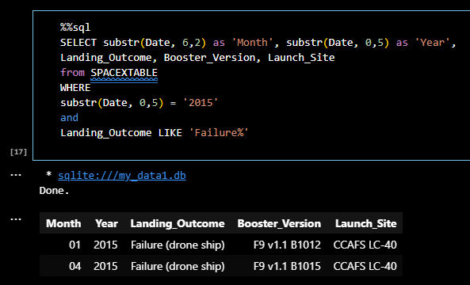
2015 Launch Records
SQLite does not support month names. So, using substr(Date, 6,2) as month to get the months and substr(Date,0,5)='2015' for year.
The first condition is that the launch must be in 2015.
And the second condition is that the launch is classified as a failure.
Figure 18: 2015 Launch Failure Records

Slide 34
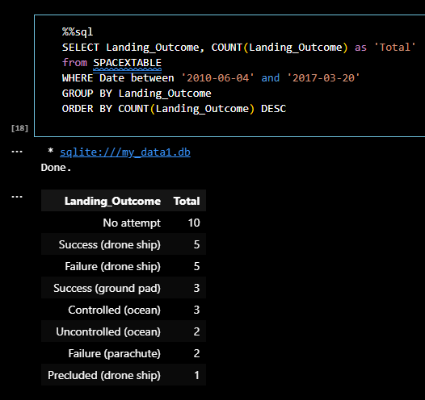
Rank Landing Outcomes Between 2010-06-04 and 2017-03-20
The BETWEEN operator selects values within a given range.
The DESC command is used to sort the data returned in descending order.
The condition here is that the experimental data collection date must be between June 4, 2010 and March 20, 2017.
Figure 19: Rank Landing Outcomes

Slide 35

Section 3

Slide 36
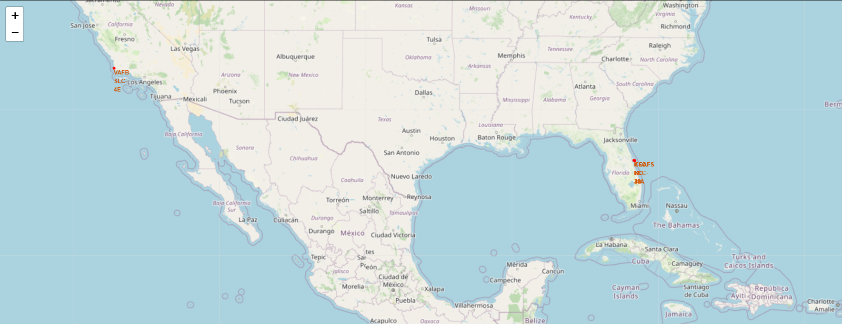
Marked Launch Sites
There are a total of 4 launch sites in the map shown.
Particularly, the 3 launch sites, “CCAFS LC-40”, “CCAFS SLC-40”, “KSC LC-39A”, are located quite close to each other, so the names of launch site are overlapped.
Figure 20: Folium map with marked launch sites

Slide 37
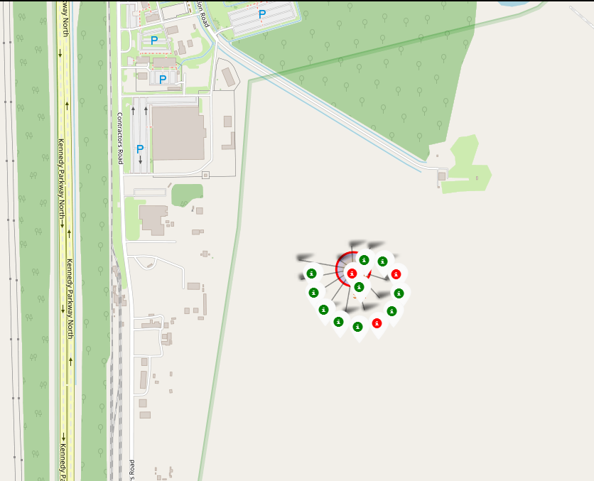
Color-labeled Launch Outcomes
This is KSC LC-39A launch site.
Clusters on Folium map can be clicked on to display each successful landing (green icon) and failed landing (red icon).
Figure 21: Folium map color-labeled launch outcomes

Slide 38
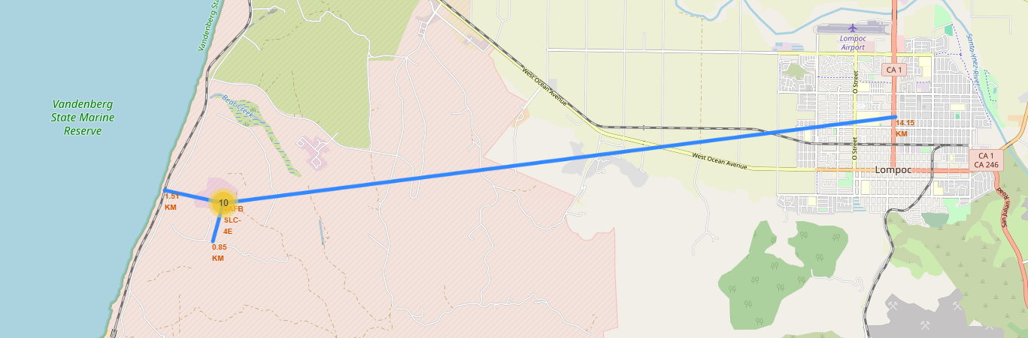
Proximities
Using VAFB SLC-4E as an example, launch sites are very close to railways for large part and supply transportation (1,51 km).
Also close to highways for human and supply transport (0,85 Km).
And especially far away from city areas to avoid affecting the city and its people (14,15 km).
Figure 22: Folium map with Proximities

Slide 39

Section 4

Slide 40
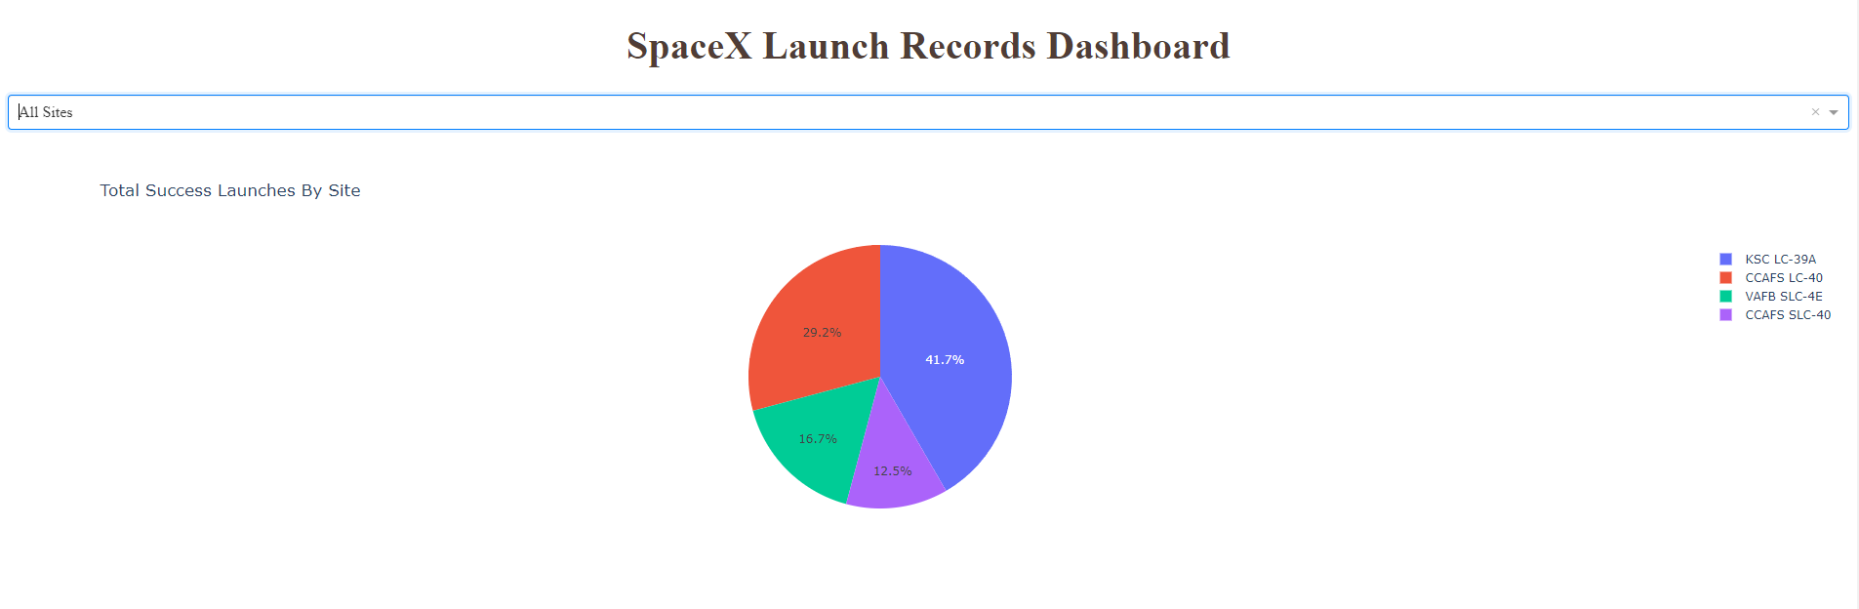
Successful Launches Across Launch Sites
Figure 23: All launch site success rate
This is the distribution of successful landings across all launch sites.
CCAFS LC-40 is the old name of CCAFS SLC-40 so CCAFS and KSC have the same landing success rate.
VAFB has the smallest successful landing rate.

Slide 41
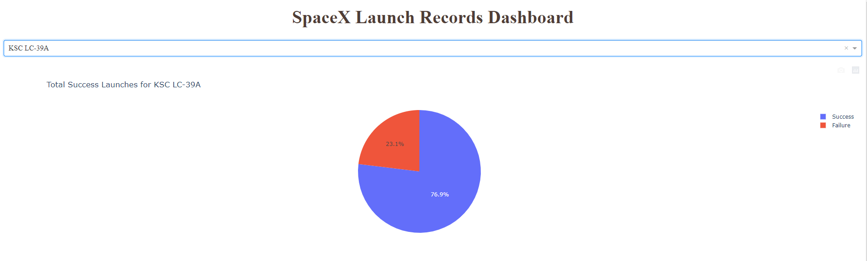
Launch Site Highest Success Rate
Figure 24: Launch Site has the highest success rate
KSC LC-39A has the highest success rate with 10 successful landing and 3 failed landing

Slide 42
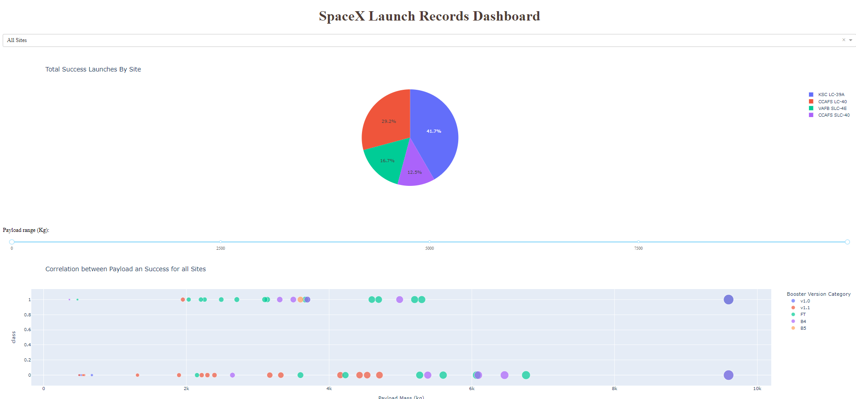
Payload Mass vs. Success vs. Booster Version Category
Figure 25: Scatter plot Payload Mass vs. Success Rate vs. Booster Version Category
The Dashboard has a Payload slider with values set from 0 - 10,000 kg.
The class represents 1 for a successful landing and 0 for a failed landing.

Slide 43

Section 5

Slide 44
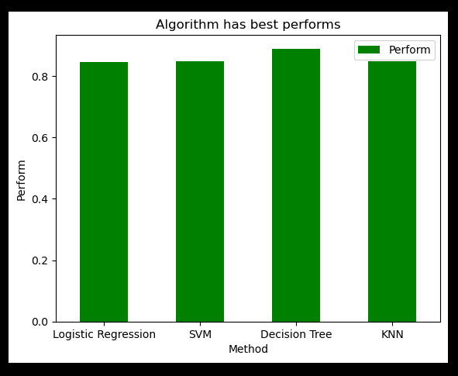
Classification Accuracy
The model with the highest performs is “Decision Tree” with value of 87.5%.
Figure 26: Bar Plot Model Accuracy

Slide 45
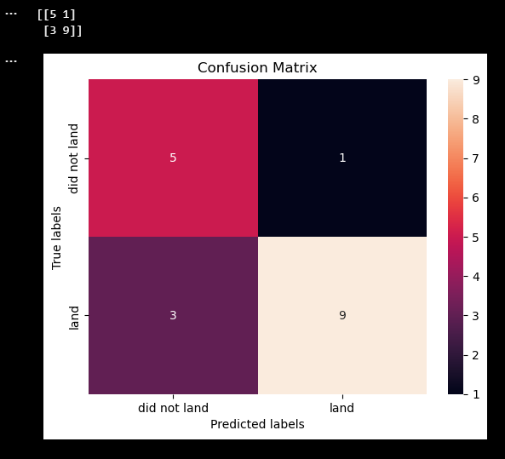
Confusion Matrix
The values obtained are:
True Positive: 9
True Negative: 3
False Positive: 5
False Negative: 1
Figure 27: Confusion Matrix

Slide 46
Conclusions
SpaceX advertises Falcon 9 rocket launches on its website with a cost of 62 million dollars; other providers cost upward of 165 million dollars each, much of the savings is because SpaceX can reuse the first stage.
After finished the project we can conclude that:
The larger the flight amount at a launch site, the greater the success rate at a launch site.
Launch success rate started to increase in 2013 till 2020.
Orbits ES-L1, GEO, HEO, SSO, VLEO had the most success rate.
KSC LC-39A had the most successful launches of any sites.
The Decision tree classifier is the best machine learning algorithm for this task.

Slide 47
Appendix
Include any relevant assets like Python code snippets, SQL queries, charts, Notebook outputs, or data sets that you may have created during this project

Slide 48


